Slide 1

The Generative AI Revolution: A Month-Long AI Exploration
Week 1 Day 1: 3rd Feb 2024

Slide 2

π
Generative AI Cohort Feb 2024
π

Slide 3






π
Agenda for Feb 2024
Introduction to Generative AI
Generative AI in Software Applications
Impact of Generative AI
Prompt Engineering
Project: Laptop Salesman Assistant Supported by AI

Slide 4


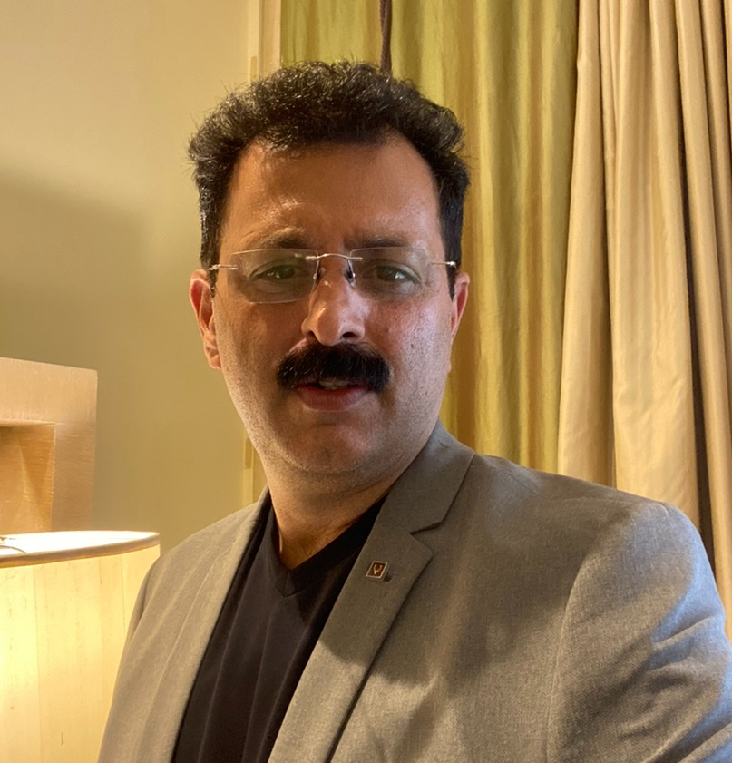

π
Our Team
Mokarbeen Ansari
www.linkedin.com/in/mokarbeenansari/
Raman Chopra​
www.linkedin.com/in/raman-chopra/
Vinit Narula
www.linkedin.com/in/vinitnarula/
Dinesh Chopra
www.linkedin.com/in/dinesh-chopra/
Email: mentor_gen_ai@groups.outlook.com

Slide 5
π
Introduction to Generative AI
What is Generative AI ?
Examples of Generative AI
Limitations of Generative AI
π

Slide 6

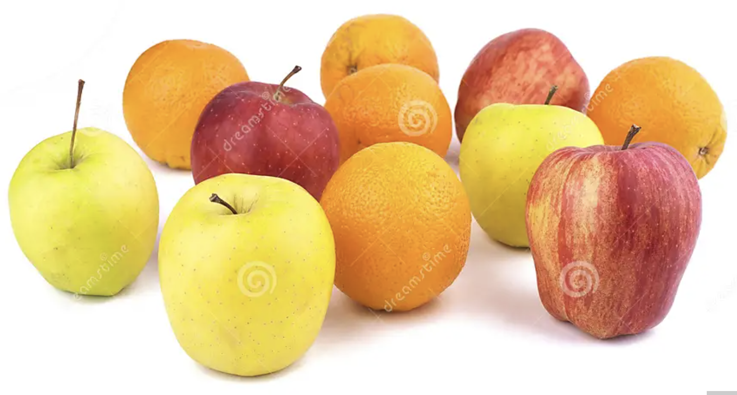
π
What is Machine Learning ?
Machine Learning (ML) is a subset of Artificial Intelligence that involves the development of algorithms enabling computers to learn from data and improve their performance on a specific task without being explicitly programmed.
It focuses on the
creation of models that can recognize patterns,
make predictions,
adapt to new information.
Notes:
Story , How to teach a kid about apples and oranges, on the similar way Machine Learning learn by providing some examples.

Slide 7
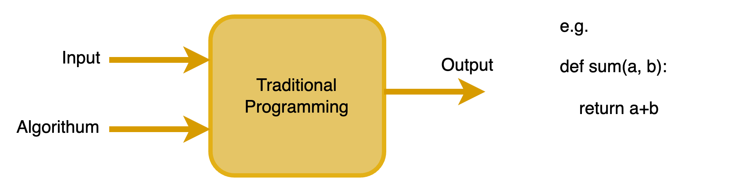
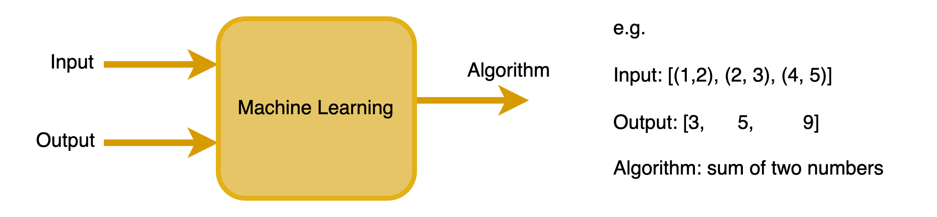
π
How Traditional Programming different from Machine Learning ?

Slide 8
π
What is Artificial Intelligence ?
Generative AI
Supervised Learning
Un-Supervised Learning
Reinforcement Learning

Slide 9
π
What is Generative AI ?
Artificial intelligence systems that can produce / generate high quality content, specifically text, images, and audio.

Slide 10





π
Examples of Generative AI Applications

Slide 11
π
Examples of Generative AI for Image
DALL.E (OpenAI)
MidJourney (accessed via discord)
Dream Studio (stability ai)
Firefly (Adobe)
Getty (Getty)

Slide 12
π
Examples of Generative AI for Audio
LOVO
11-LABS
SPEECHIFY
MURF
Many more ...
More Details: https://www.youtube.com/watch?v=hxnTwyx8GS8

Slide 13


π
Q & A

Slide 14
π
Examples of Generative AI Applications with Text
Writing, Reading and Chatting
π

Slide 15
π
Gen AI Applications for Writing
Brainstorming
Sales (Developing Sales Strategy)
Writing a press release
Translation

Slide 16
π
Gen AI Applications for Reading
Summarizing an Article
Summarizing Call center conversation
Customer email analysis
Reputation Monitoring
Many more ...

Slide 17
π
Gen AI Applications for Chatting
Customer Service Chatbot
Specialized Chatbot
IT Service Chatbot

Slide 18
π
Q & A

Slide 19
π
Limitations of Gen AI ?
π

Slide 20
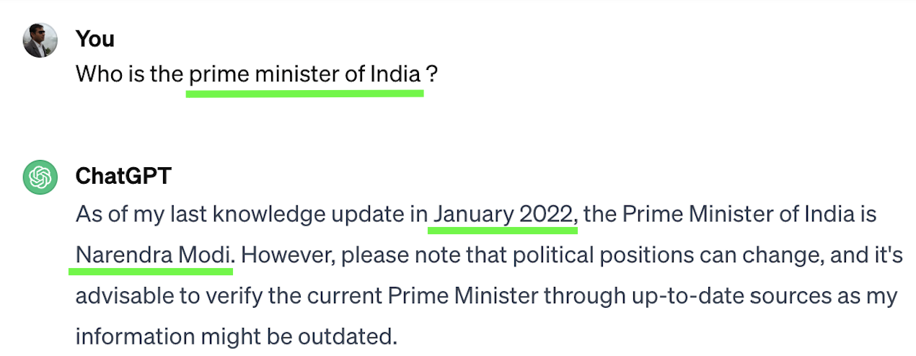
π
Limitations of Gen AI: Knowledge Cutoff
Knowledge Cutoff: An LLM’s knowledge of the world is frozen at the time of its training

Slide 21

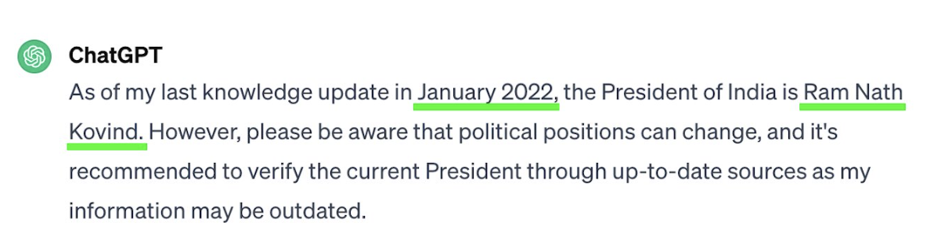
π
Limitations of Gen AI: Knowledge Cutoff

Slide 22

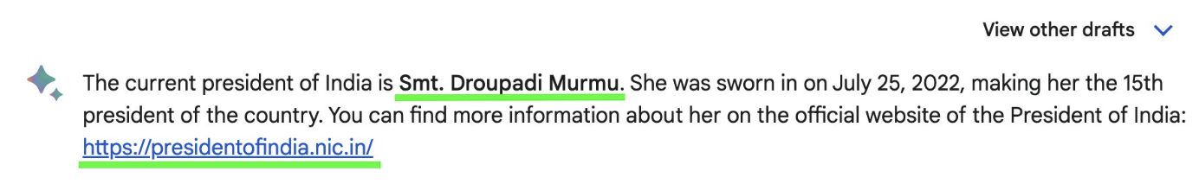
π
Limitations of Gen AI: Knowledge Cutoff

Slide 23
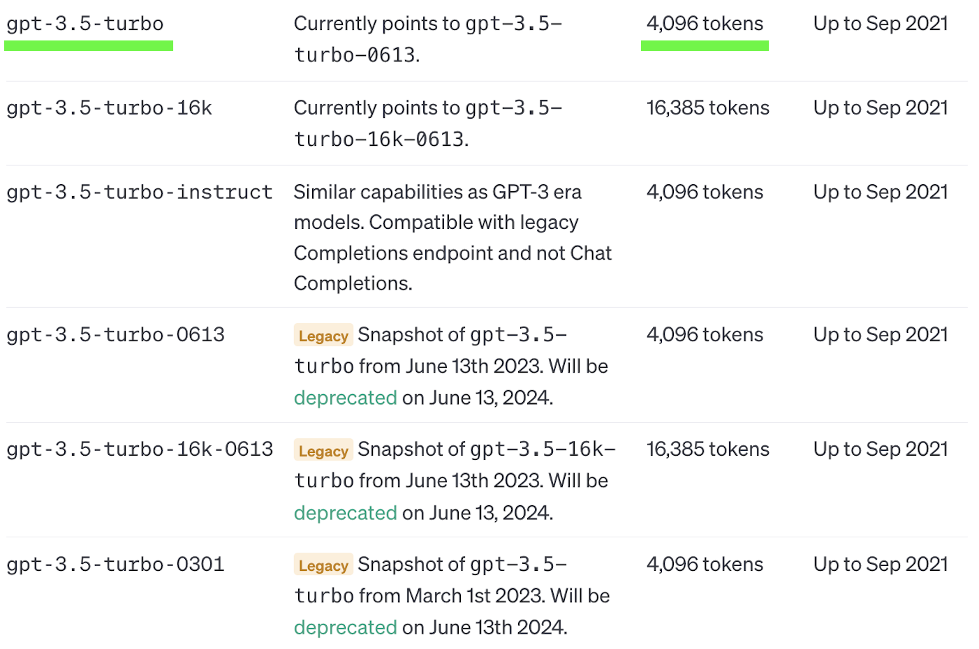
π
Limitations of Gen AI: Token Limits
Source: https://platform.openai.com/docs/models/gpt-3-5

Slide 24
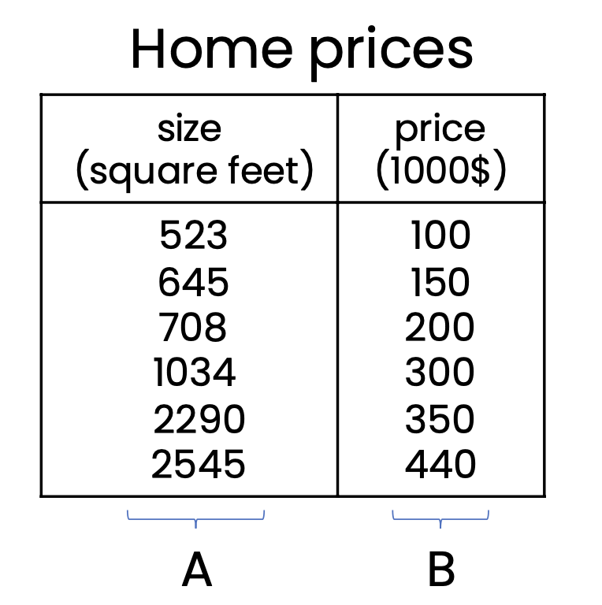
π
Limitations of Gen AI: Tabular Data
Gen AI does not work well with structured (Tabular) data.
Supervised Machine Learning is best for tabular datasets

Slide 25
π
Q & A

Slide 26
π
Summary
What is Generative AI ?​
Examples of Generative AI​
Limitations of Generative AI

Slide 27
π
Mokarbeen Ansari
www.linkedin.com/in/mokarbeenansari/
Raman Chopra​
www.linkedin.com/in/raman-chopra/
Vinit Narula
www.linkedin.com/in/vinitnarula/
Dinesh Chopra
www.linkedin.com/in/dinesh-chopra/
Thank You!

Slide 28
The Generative AI Revolution: A Month-Long AI Exploration
Week 1 Day 2: 4th Feb 2024

Slide 29
π
Leveraging Generative AI within software applications.
Agenda for today:
Software applications & examples
Basics of prompt
The life cycle and application scenarios of Generative AI
Methods for enhancing Generative AI applications
π

Slide 30
π
Gen AI Application Types
Text Generation
Image Generation
Music Generation
Video Generation
Data Augmentation
Design and creativity
Game Development
Drug discovery
Language translation and Generation
Content creation and marketing
Many more…

Slide 31
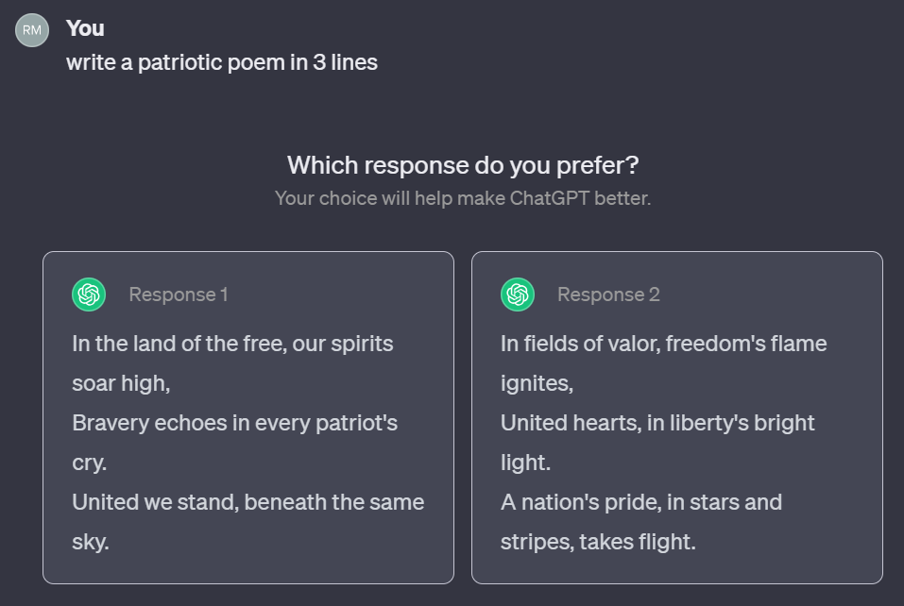
π
Gen AI Examples:
Writing
Prompt: Is delivery service offered at your showroom?
Response: Certainly, you have the option to select fast delivery. With this option, we guarantee delivery on the same day.

Slide 32
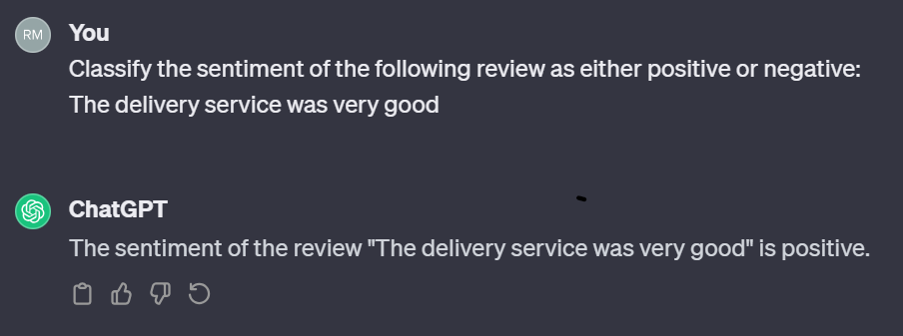
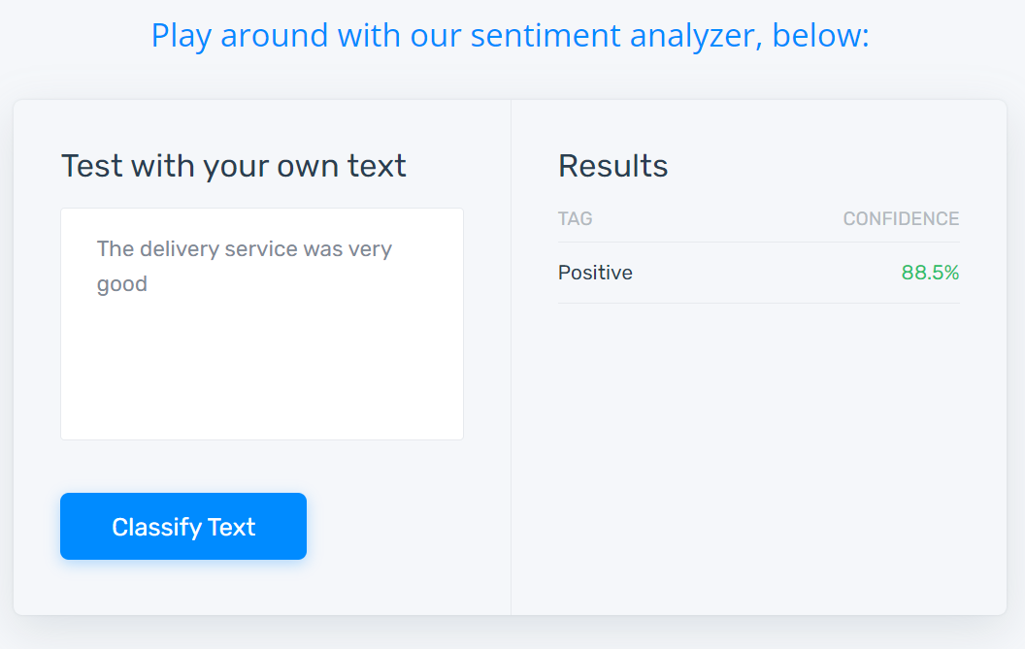
π
Gen AI Examples
Reading
Prompt: Classify the sentiment of the following review as either positive or negative:
The delivery service was very good
Response <as shown in the screenshots>

Slide 33
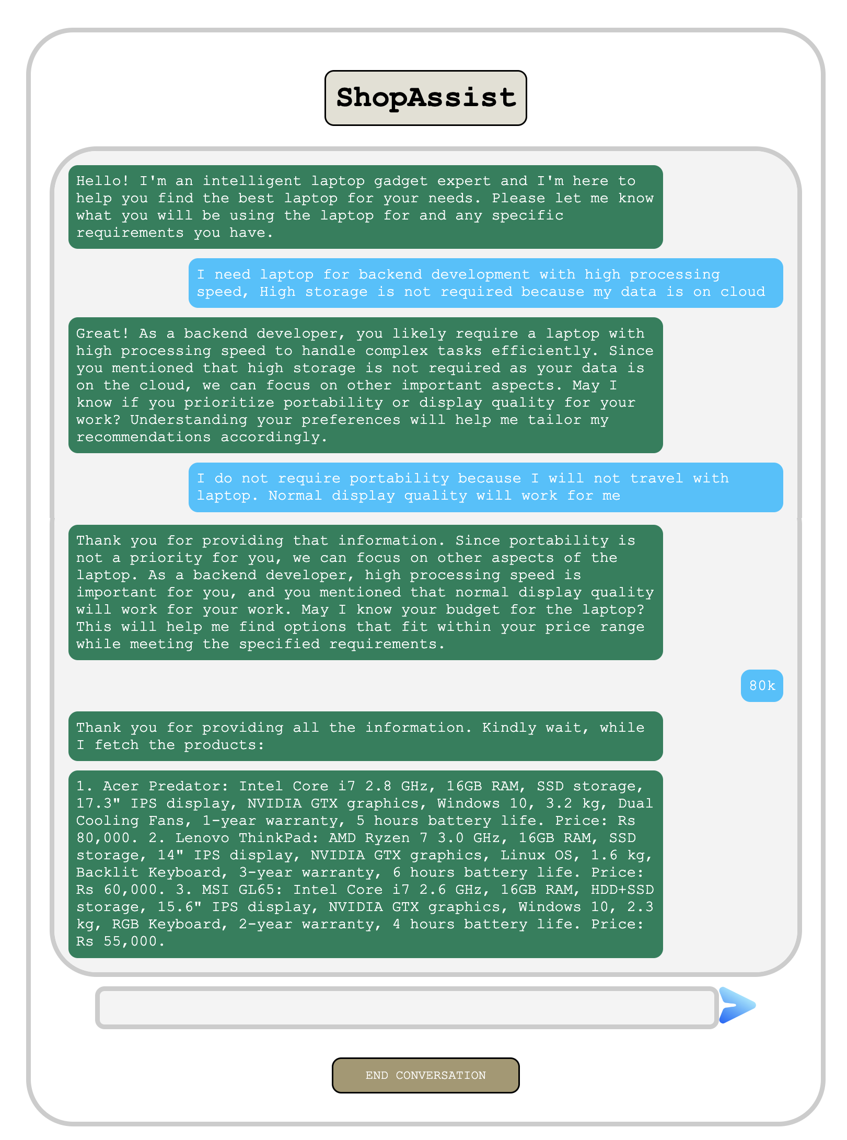
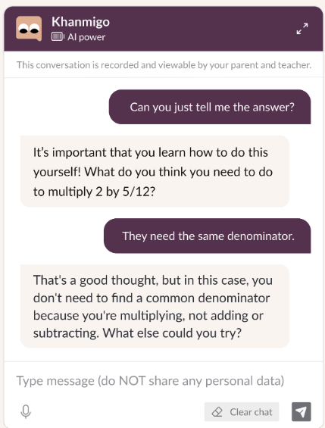
π
Gen AI Examples
Chatting
Bot: Welcome to the showroom!
User: I am looking for a laptop
Bot: Win. Mac. or Linux ?
User: Windows
Bot: i3, i5, i7
User: i7

Slide 34
π
Q & A

Slide 35
π
Supervise learning for showroom reputation monitoring
Feeding features & label to train the model:
Feature
Label
Best assistance service I’ve ever experienced
Very Nice interaction/chatting system
Delivery person was not well dressed
Positive
Positive
Negative
Steps for Supervised learning:
Get labelled data
Train AI model on data
Deploy (run) model
Input: “Best delivery service I’ve ever had”
Output: Positive

Slide 36
π
Prompt-based development
prompt =
“Classify the following review as having either a positive or negative sentiment:
The delivery service was really very good”
response = llm_response(prompt)
print(response)
Instruction text
Review text
Code to call LLM
Code to print output

Slide 37
π
Workflow using Generative AI
Get labelled data
Train AI model on data
Deploy (run) model
Supervised learning
1 month
3 months
3 months
Specify prompt
Deploy (run) model
Prompt-based AI
minutes/hours
hours/days

Slide 38
π
Q & A

Slide 39

π
Lifecycle of a Generative AI project
Scope Project
Build System
Internal Evaluation
Number
positive
reviews
per day
Classify the sentiment of the following review as either positive or negative:
The delivery service was very good
Number
negative
reviews
per day
time
Initially a prototype, that we will improv over time
Negative
Incorrect
response

Slide 40
π
Lifecycle of a Generative AI project
Scope Project
Build/Improve system
Internal evaluation
Number
positive
reviews
per day
Classify the sentiment of the following review as either positive or negative:
The delivery service was very good
Number
negative
reviews
per day
time
Initially a prototype, that we will improv over time
Negative
Incorrect
response

Slide 41
π
Lifecycle of a Generative AI project
Scope Project
Build/Improve system
Internal evaluation
Deploy and monitor
Number
positive
reviews
per day
Classify the sentiment of the following review as either positive or negative:
The delivery service was very good
Number
negative
reviews
per day
time
Initially a prototype, that we will improv over time
Positive

Slide 42

π
Lifecycle of a Generative AI project
Scope Project
Build System
Internal Evaluation
Take Laptop order
Let team order …
User: I require a i3 windows laptop
Bot: Apologies, we don't carry the i3 series. Would you be interested in the i5 or i7 series instead?
Incorrect
Response As we currently have i3 laptops in stock

Slide 43
π
Lifecycle of a Generative AI project
Scope Project
Build/Improve System
Internal Evaluation
Take Laptop order
Let team order …
User: Do you have windows ?
Bot: Yes – would you like to buy ?

Slide 44
π
Lifecycle of a Generative AI project
Scope Project
Build/Improve System
Internal Evaluation
Deploy and Monitor
Take Laptop order
User: How much RAM does the Windows laptop have?
Bot: I’m sorry, I don’t know

Slide 45
π
Lifecycle of a Generative AI project
Scope Project
Build/Improve System
Internal Evaluation
Deploy & Monitor
Take Laptop order
User: How much RAM does the Windows laptop have?
Bot: About 4 to 32 GB

Slide 46
π
Q & A

Slide 47
π
Tools to improve performance
Building Generative AI is a highly empirical (experimental) process – we repeatedly find and fix mistakes.
Prompt Engineering
Retrieval augmented generation (RAG)
Give LLM access to extend data source
Fine-tune models
Adapt LLM to your task
Pretrain models
Train LLM from scratch

Slide 48




π
Advanced Technologies Beyond Prompting:
{
}
2
prompt
Search Relevant Information
Knowledge Source
3
Relevant
Context
1
prompt
LLM Endpoint
4
Prompt + Context
5
Generated Response
Retrieval Augmented Generation (RAG) Architecture

Slide 49
π
Pre-training
Expected output: My favourite laptop is XYZ with i7
Input (A)
Output
My favourite laptop is
My favourite laptop is XYZ
My favourite laptop is XYZ with
XYZ
with
i7
Learns from 100Bs of words

Slide 50
π
Fine-tune:
To assist LLM in acquiring specialized knowledge.
RAM: 4GB, 8GB, 16GB, 32GB
CPU: Inte’l, AMD, Apple silicon qualcomm
GPU: Nvidia, AMD Radeon, Qualcomm Adreno, Apple Silicon Integrated GPU, Intel Integrated Graphics
e.g. What a performance laptop
Input
Output
What
What a
What a performance
a
performance
laptop
Learns from 1000s to 10,000s of words

Slide 51
π
Q & A

Slide 52
π
Summary
Software applications & examples
The life cycle of Generative AI
Enhancing Generative AI

Slide 53
π
Q & A

Slide 54
π
Thank You!
Raman Chopra​
www.linkedin.com/in/raman-chopra/

